Slide 1

REAL TIME WEATHER
DETECTION
SUBMITTED BY:
M INDHUJA NATCHIYAR
P AARTHI SHIVANI

Slide 2

ABSTRACT:
This project presents a real-time weather detection system using computer vision techniques.It classifies weather as Sunny, Cloudy, or Rainy/Dark by analyzing the sky region in webcam video.HSV color space is used for robust color-based segmentation.The system uses pixel ratio thresholds for weather classification

Slide 3

INTRODUCTION:
Weather classification has applications in smart agriculture, surveillance, and outdoor planning.
Traditional weather APIs may not work in offline scenarios or for hyper-local observations.This solution uses local visual cues to determine weather conditions

Slide 4
OBJECTIVE:
To build a simple and efficient system that detects weather conditions in real time.Classify sky visuals
into three main types:
Sunny: Predominantly blue sky
Cloudy: High amount of gray pixels
Rainy/Dark: Low visibility of both blue and gray

Slide 5
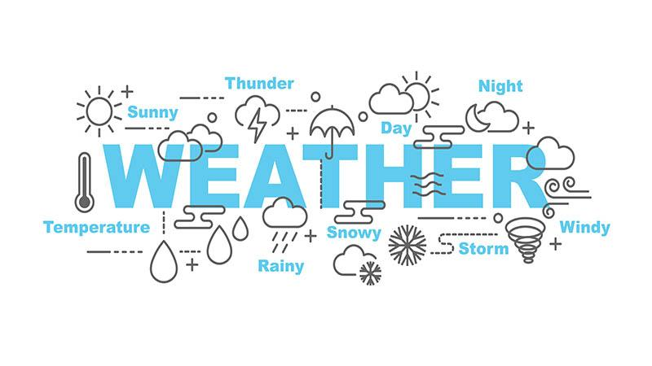
TOOLS USED:
Python – Core language
OpenCV – For image capture and processing
NumPy – For numerical operations
Webcam – For live video input

Slide 6
METHODOLOGY:
This project uses a webcam to detect the weather by analyzing the sky in real-time video. It looks at the top half of each video frame, assuming it shows the sky. The image is converted to HSV color format to easily find blue (clear sky) and gray (cloudy sky) areas. It calculates how much of the sky is blue or gray and uses that to decide if the weather is sunny, cloudy, or rainy/dark.

Slide 7
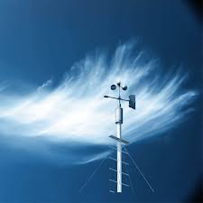
LIVE DETECTION:
The webcam shows live video.
The program looks at the sky in each frame.
It checks the sky color (blue or gray).
It tells if the weather is sunny, cloudy, or rainy.
The weather result appears on the screen.
It updates every second.

Slide 8
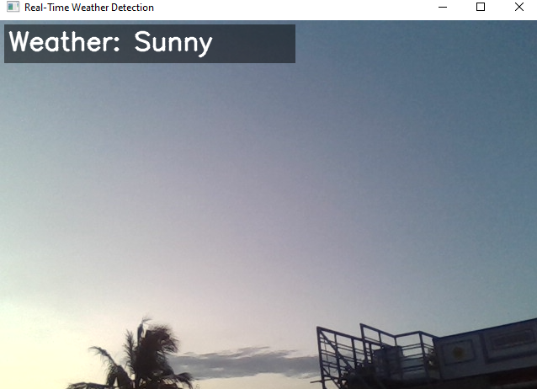

Slide 9
FUTURE ENHANCEMENTS:
The system can be improved by checking brightness to tell the difference between night and rain. It can use AI to detect the sky more accurately instead of just looking at the top half of the image. Saving weather data with time and date can help keep records. Better color detection can make results more reliable. Adding sounds when the weather changes can alert users. Showing weather icons instead of text makes it easier to understand. The system can also be made to work on phones or online for more convenience.

Slide 10
CONCLUSION:
this system uses webcam video and color analysis to detect basic weather conditions like sunny, cloudy, or rainy in real time. While it is simple and effective, there is room to improve accuracy by adding features like brightness checks, smarter sky detection, and better color filters. Overall, this project demonstrates how computer vision can help understand the environment using just a camera.

Slide 11


